Slide 1

Water and Power Prediction
Vinicius Parzanini,
Eoin Delaney,
Arnas Magilevičius

Slide 2



What is it?
Analysis and Prediction of water and power consumption
Continuation of a previous project
Front-end and Back-end
Data Visualisation and A.I. Prediction

Slide 3
The importance of predicting water and power usage
It allows for better planning and management of energy resources in the college.
Realize saving opportunities in the future.
Better able to troubleshoot power quality issues.

Slide 4


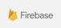


Possible Software
Front-end: Angular.
Back-end: MySQL.
Authenticator: Firebase.
Hosting Services: GCP or AWS.

Slide 5

Front-End Design

Slide 6
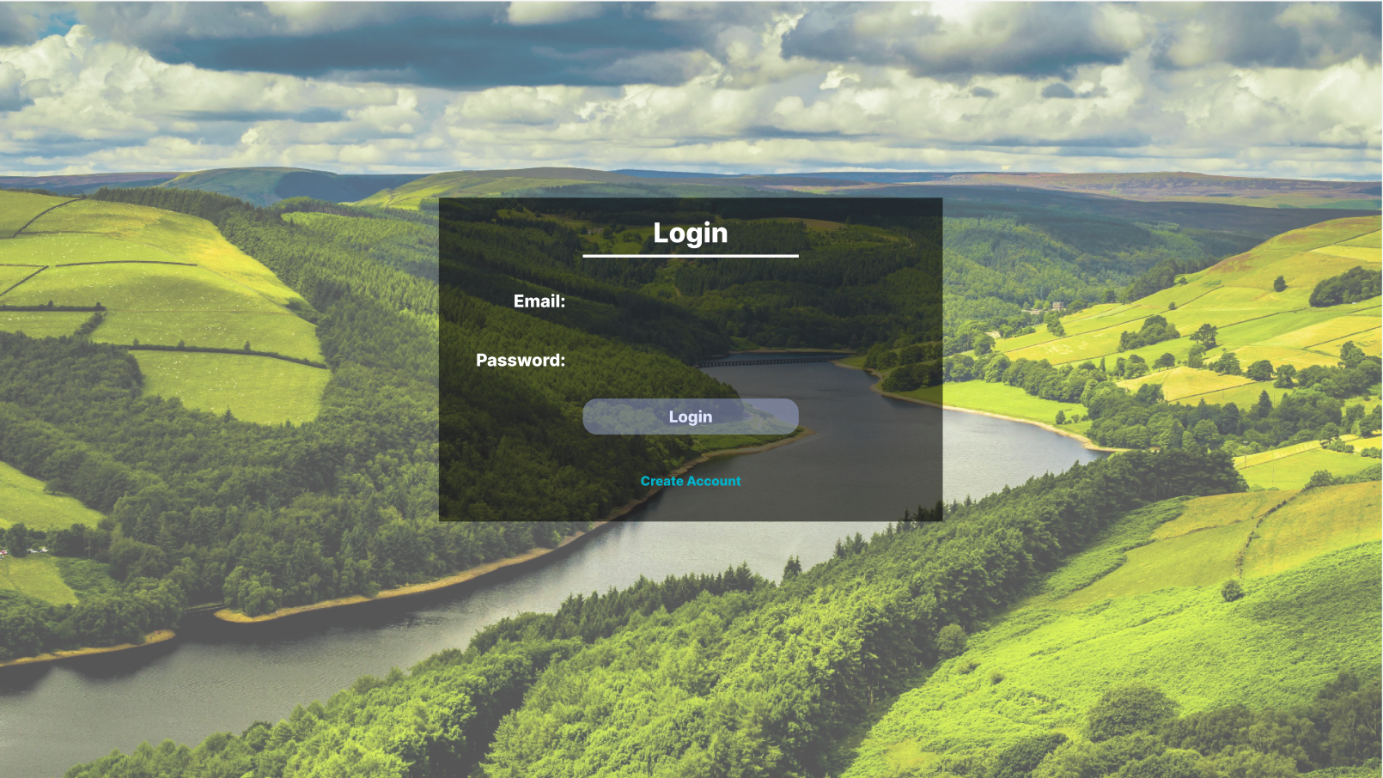
Prototype
Login Page
Possible to use a third-party software called Firebase to take care of the validation.
Background picture might change.

Slide 7
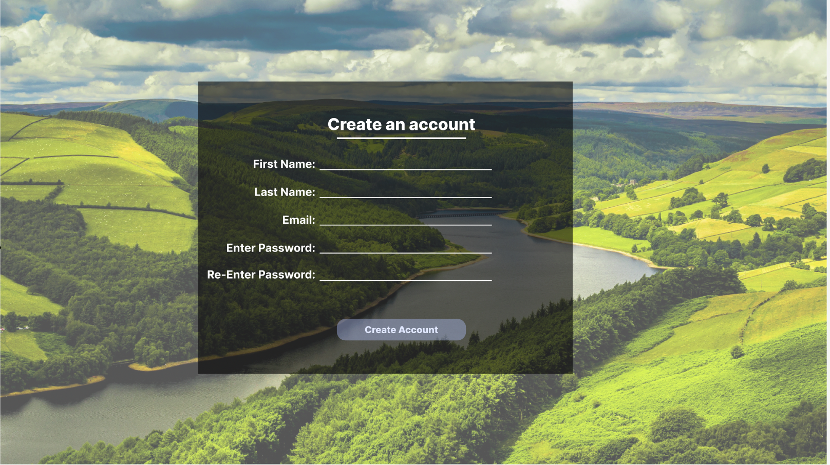
Prototype
Create an Account Page
Using JavaScript to validate the email and to check if the passwords match.

Slide 8
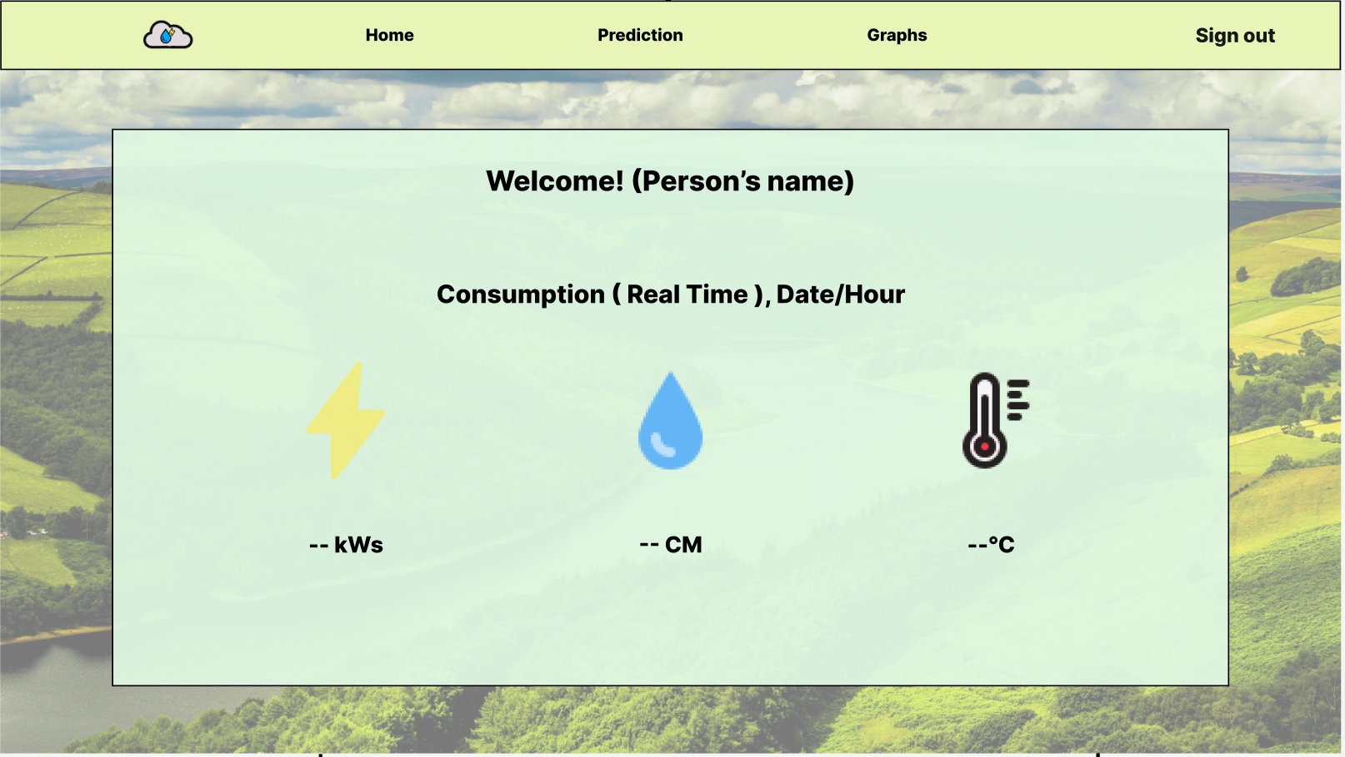
Prototype
Dashboard
Daily consumption.(Starts 00:00 AM)
The consumption displayed in the dashboard will be real-time.
The temperature displayed will be the current temperature in Thurles.

Slide 9
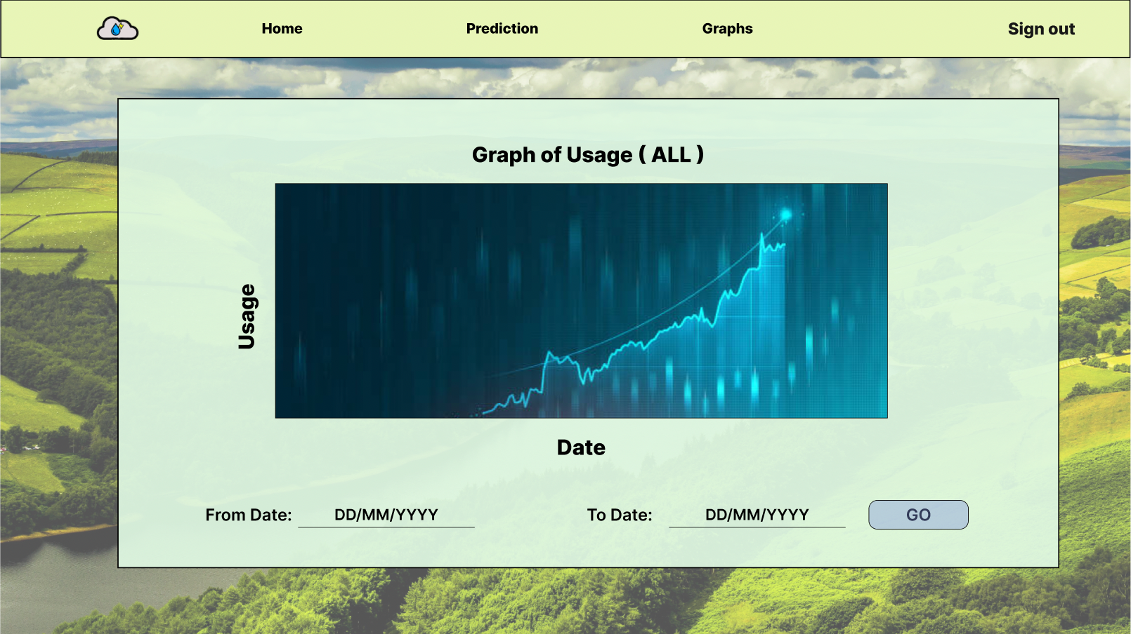
Prototype
Graphs
Start of graphs page will display the graph of lifetime usage
User will be able to narrow it down.

Slide 10
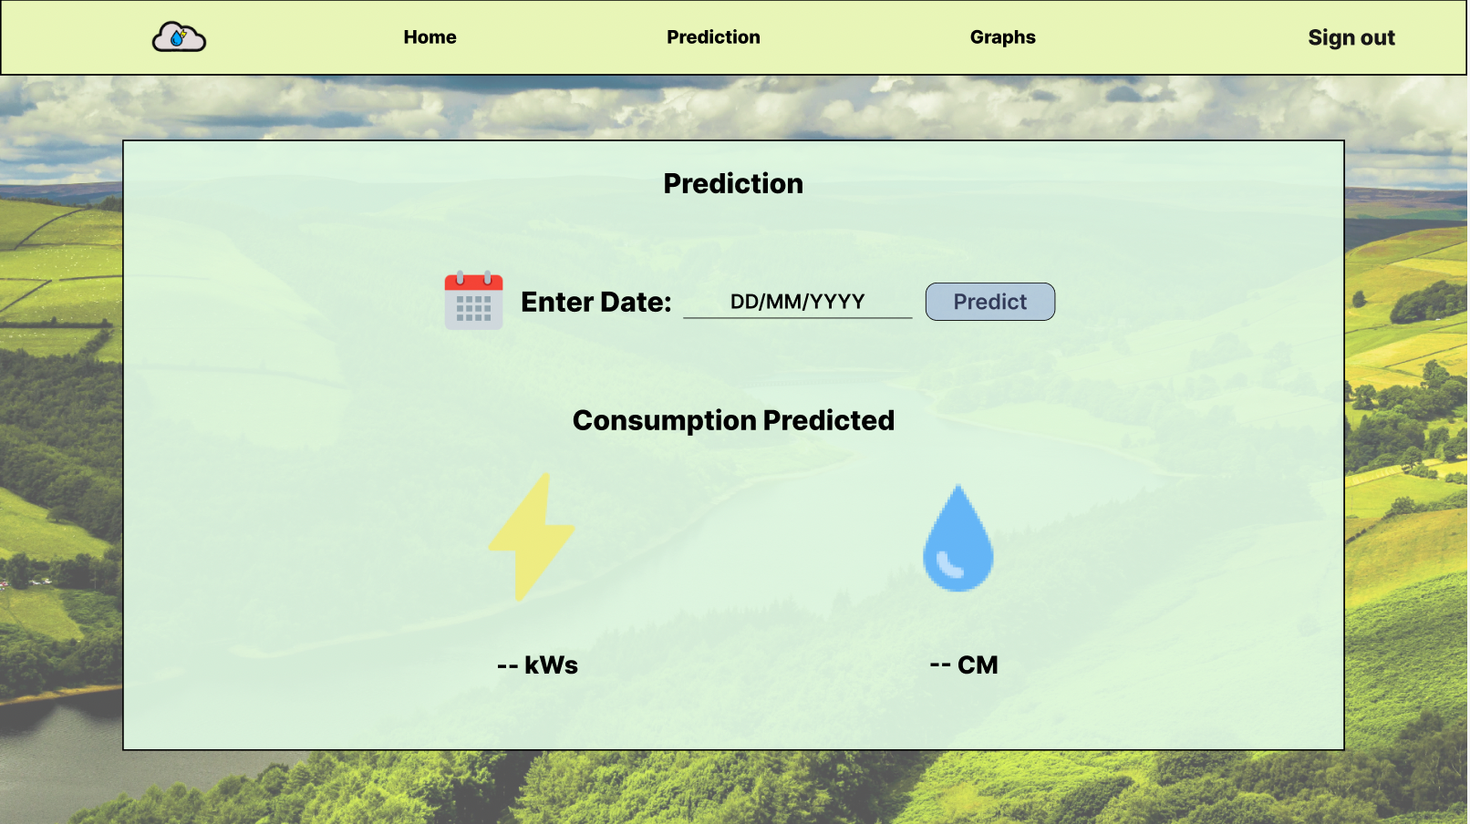
Prototype
Prediction page
Users will get an idea of how much water and electricity the college will spend from the next day onwards.

Slide 11

LOGO
The cloud represents the weather.
Water drop represents the water.
Lightning represent the energy.

Slide 12

Back-End Design

Slide 13
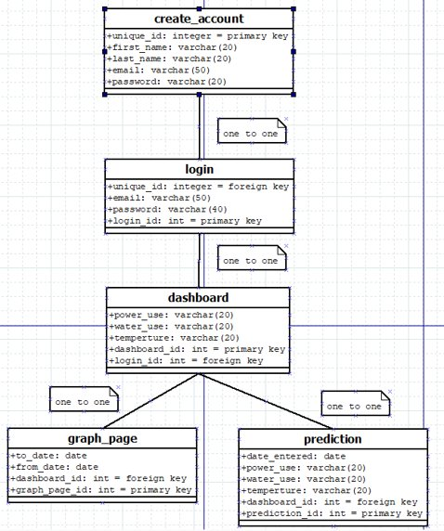
ERD
Based on the prototype, this is our ERD.

Slide 14
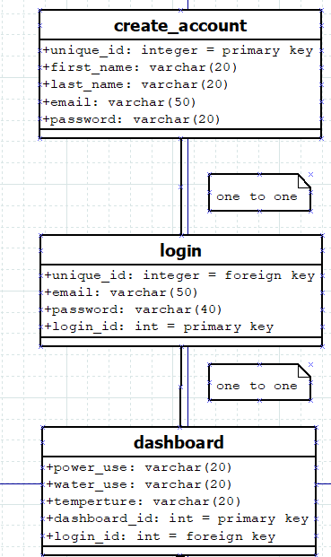
Creating an account, Login & Dashboard

Slide 15
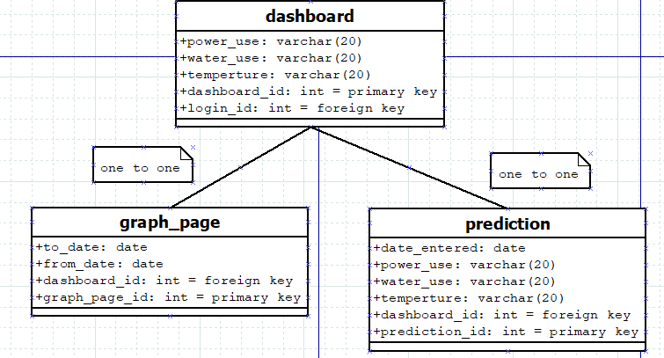
Graph Page & Prediction

Slide 16

Timeline Schedule

Slide 17
Methodology
Step 1: Requirements
Step 3: Design
Step 4: Implementation
Step 5: Review
Step 2: Planning
Agile
Cyclical
Improvement
Time Management

Slide 18
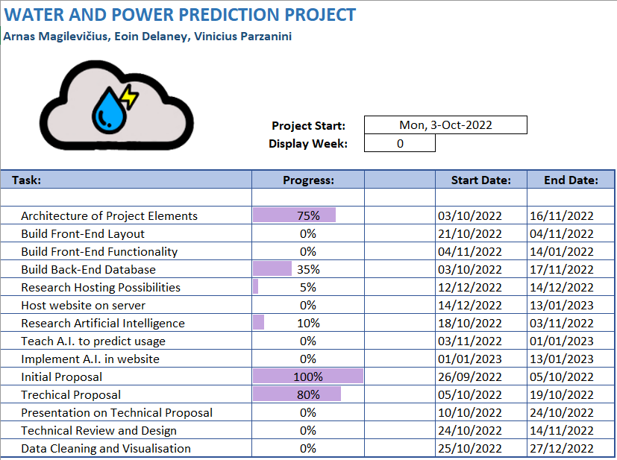

Timeline Schedule
Easy to read tasks
Progress Bar
Start/End Date

Slide 19
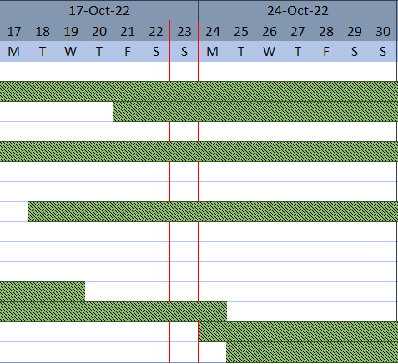
Gantt Chart
Start of Week Dates
Days and Dates
Start and Finish Times
Red Bars for Current Day

Slide 20
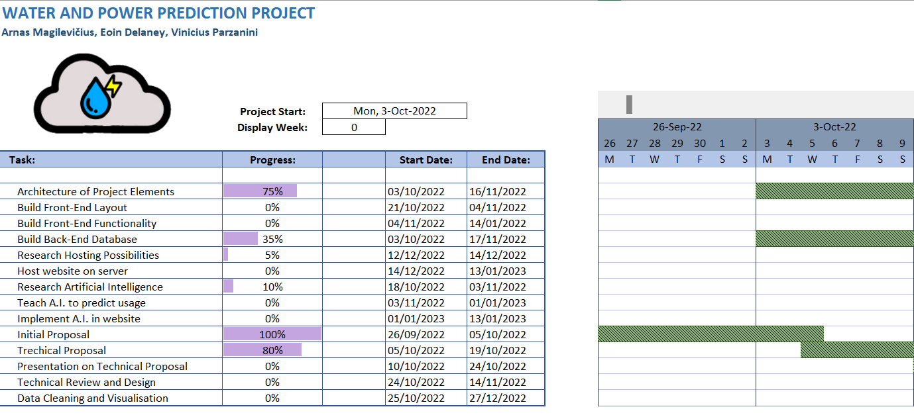
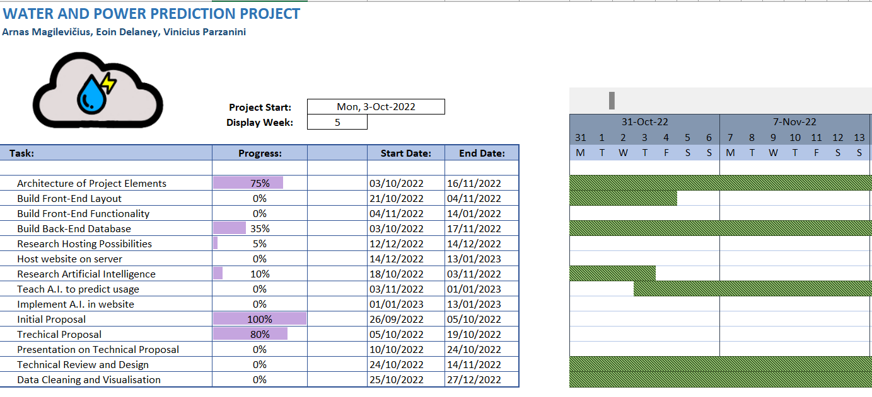
Display Week
Display Week: 0
Display Week: 5

Slide 21
Thanks for listening! Any Questions?

